Slide 1
ASP.net Web Forms Part 02
Building a Sample Web Application

Slide 2
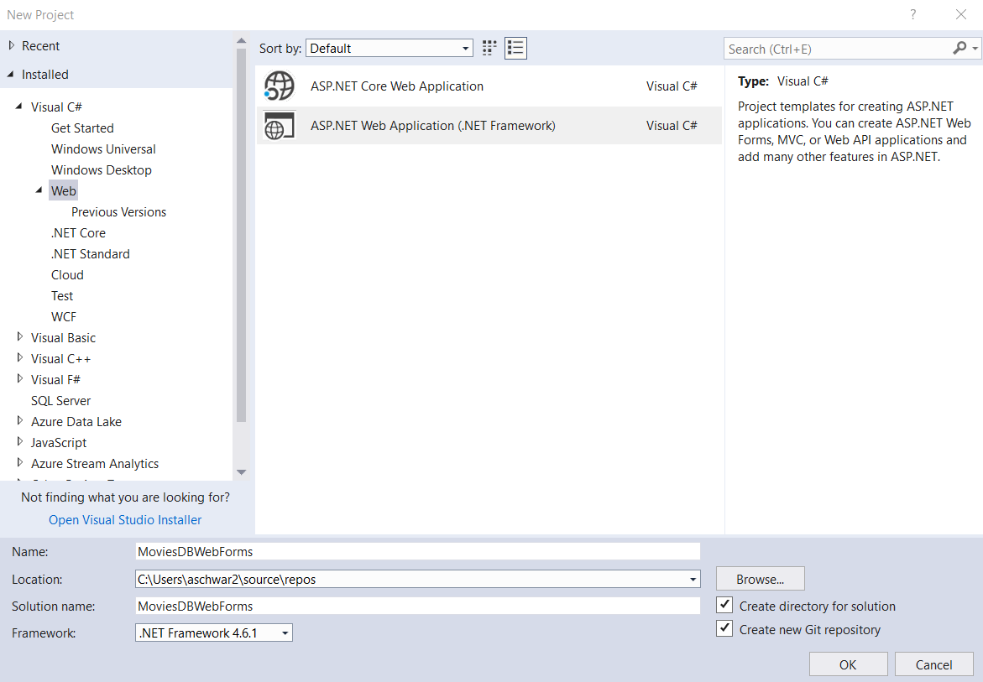
Creating the Project
Create a New Project by choosing File → New → Project
Choose ASP.NET Web Application (.NET Framework)
Click OK.

Slide 3
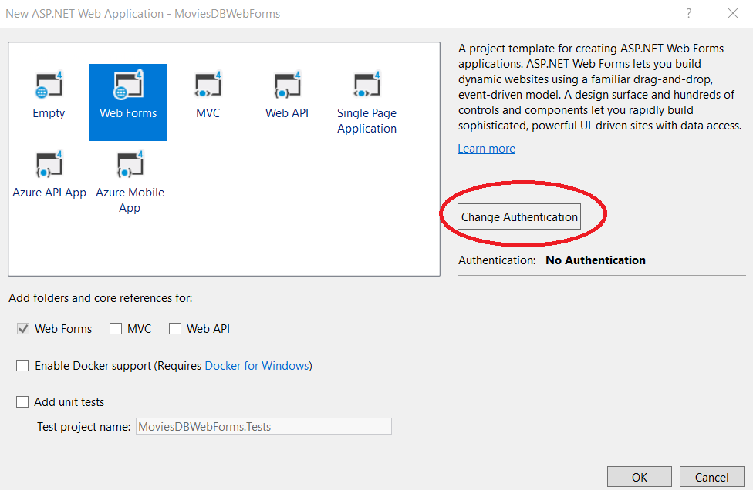
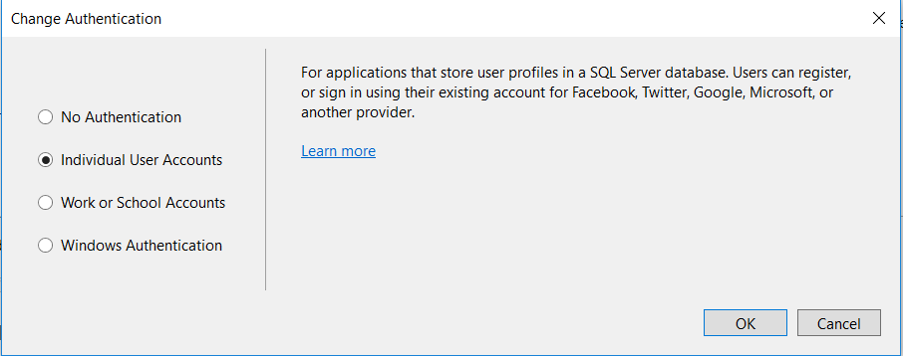
Creating the Project
Click the Change Authentication button. Select Individual User Accounts and click the OK button.

Slide 4
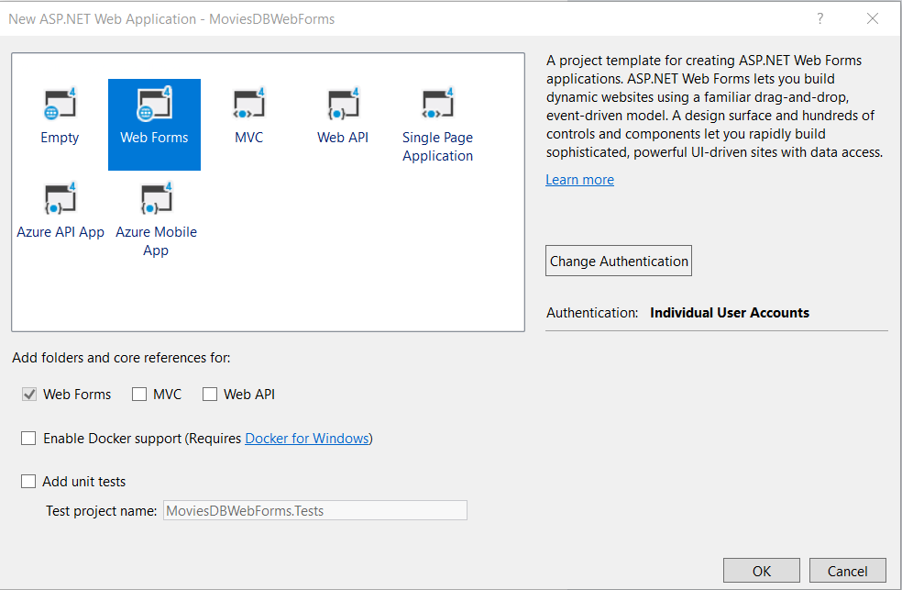
Creating the Project
Select the Web Forms template and click OK.

Slide 5
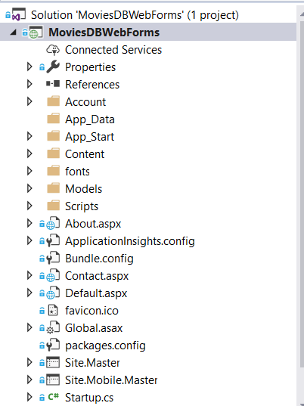
Visual Studio Overview – Solution Explorer
Solution Explorer lets you manage and view the files for the project.

Slide 6
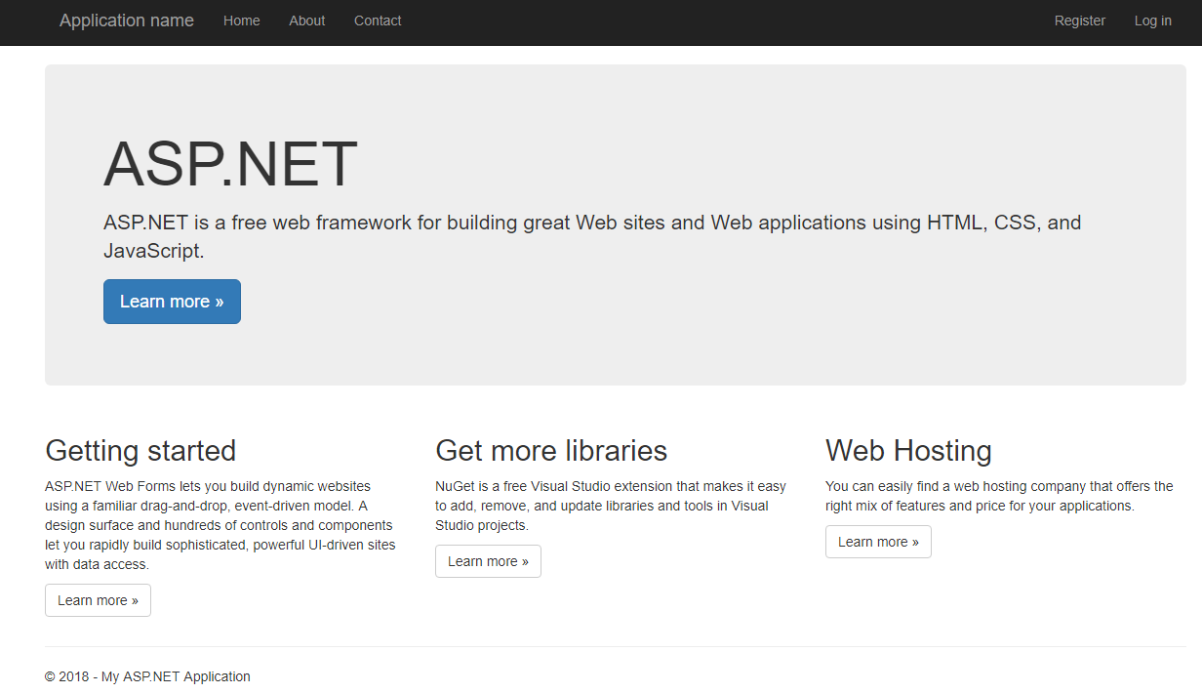
Running Default Project
Use Ctrl + F5 to run the sample project

Slide 7
ASP.NET Membership
ASP.NET Membership functionality includes the ability to register users and save their credentials so that they can log in to your website.
You enabled this when you change the Authentification
The Account folder in your project contains the files that implement various parts of membership: registration, logging in, changing a password, and authorizing access.
Optionaly, ASP.NET Web Forms also supports OAuth and OpenID
These authentification enhancements allow users to log into your site using existing credentials, from such accounts as Facebook, Twitter, Windows Live, and Google.

Slide 8
ASP.NET Membership
By default, the template creates a membership database using a default database name on an instance of SQL Server Express LocalDB.
Go ahead and test by registering a user.

Slide 9
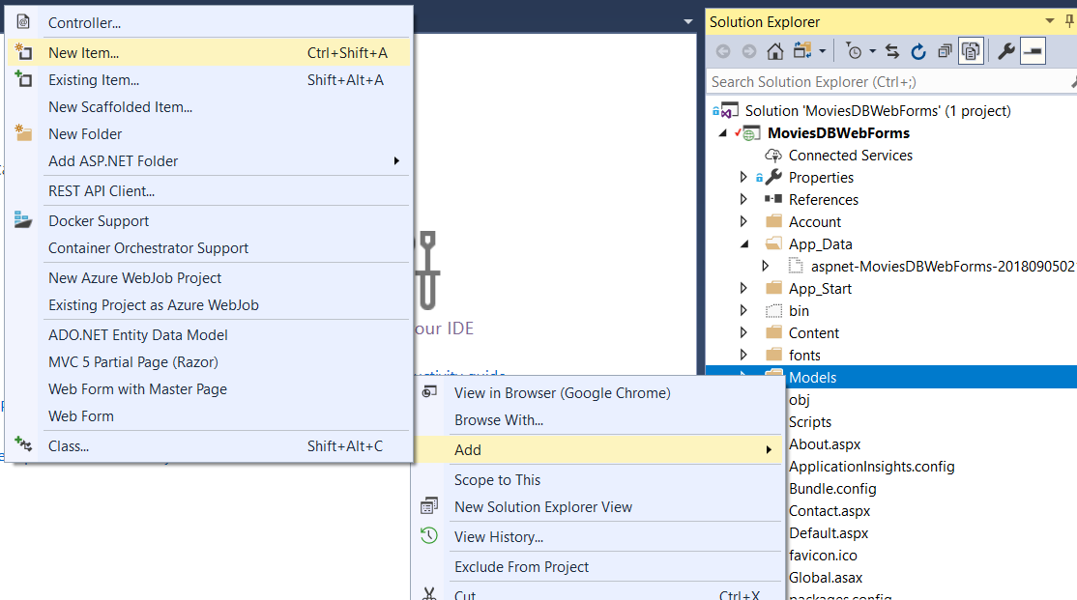
Creating Data Models
ASP.NET allows you to use Entity Framework to simplify the data access layer.
Let’s begin by creating some entity classes.
In Solution Explorer, right-click the Models folder and then select Add -> New Item.

Slide 10
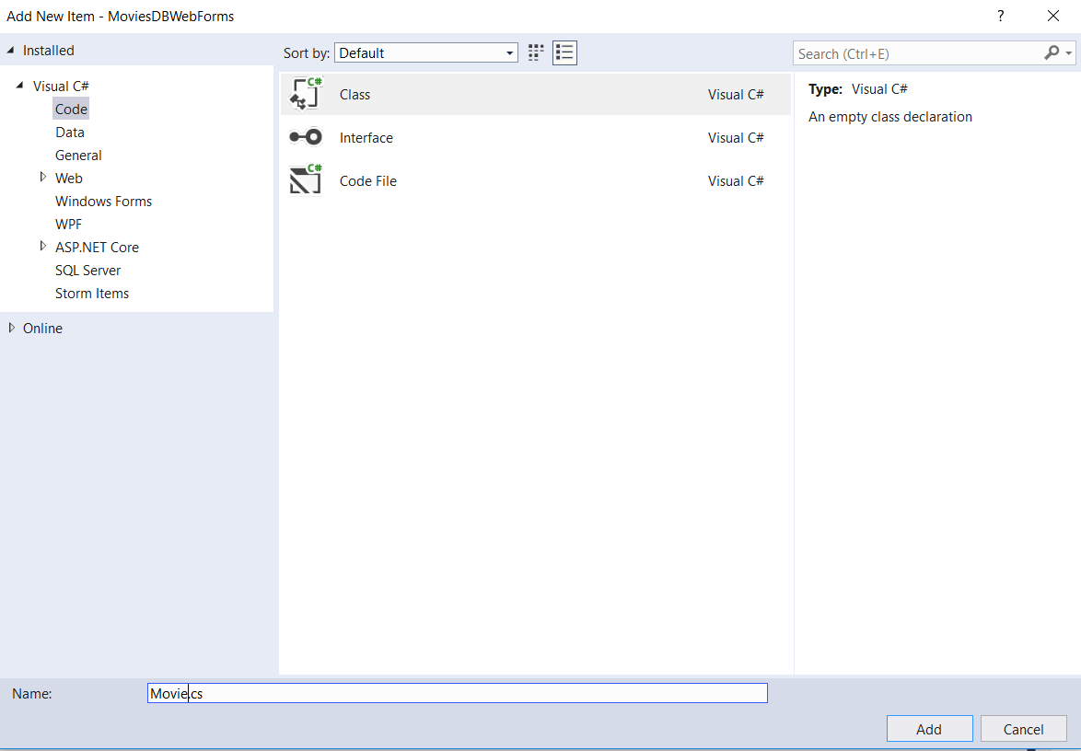
Creating Data Models
Under Visual C# from the Installed tab, select Code.
Select Class and name the class Movie.cs
Click Add.

Slide 11
Creating Data Models
Use the following code for the Movie class:
public class Movie
{
public int MovieID { get; set; }
public string Title { get; set; }
public int GenreID { get; set; }
public virtual Genre Genre { get; set; }
public int RatingID { get; set; }
public virtual Rating Rating { get; set; }
}

Slide 12
Creating Data Models
Create a class for Genre:
public class Genre
{
public int GenreID { get; set; }
public string GenreName { get; set; }
}

Slide 13
Creating Data Models
Create a class for Rating:
public class Rating
{
public int RatingID { get; set; }
public string RatingName { get; set; }
}

Slide 14
Creating Data Models
To start using the classes for data access, you must define a context class.
The context class manages the entity classes (Movie, Genre, Rating) and provides data access to the database.
Create a class called MovieContext and use the following code:
public class MovieContext : DbContext
{
public MovieContext() : base("DefaultConnection")
{
Database.SetInitializer<MovieContext>(new DropCreateDatabaseIfModelChanges<MovieContext>());
}
public DbSet<Movie> Movies { get; set; }
public DbSet<Genre> Genres { get; set; }
public DbSet<Rating> Ratings { get; set; }
}
Note you will need to add a using statement for System.Data.Entity;

Slide 15
Adding Data
Let’s create some data to put in the database.
Open Global.asax.cs and add
using (var ctx = new MovieContext())
{
var g1 = new Genre() { GenreID = 1, GenreName = "Family" };
var r1 = new Rating() { RatingID = 1, RatingName = "G" };
var m1 = new Movie() { MovieID = 1, Title = "Cars", GenreID=1, RatingID =1};
ctx.Genres.Add(g1);
ctx.Ratings.Add(r1);
ctx.Movies.Add(m1);
ctx.SaveChanges();
}
To the Application_Start method

Slide 16
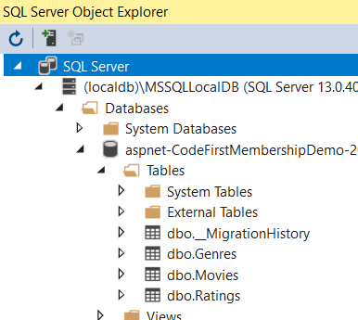
Viewing the data
Run the project (so the tables can get created)
Open Server Object Explorer to view the database

Slide 17
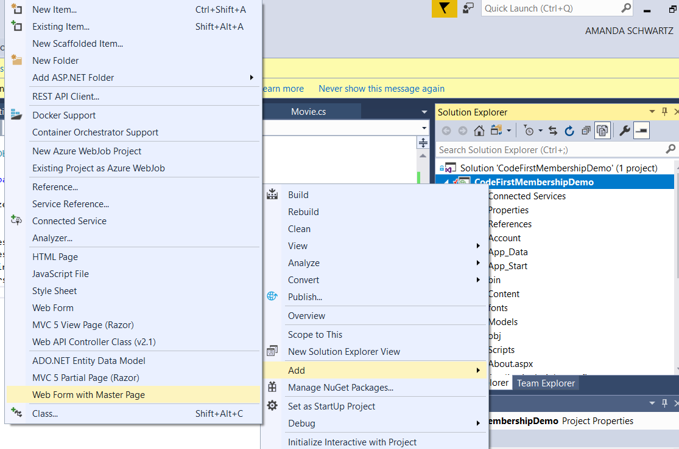
Viewing Data from UI
Add a new webform that utilizes the Master Page
Name it Movie
Use Site.Master as the masterpage

Slide 18
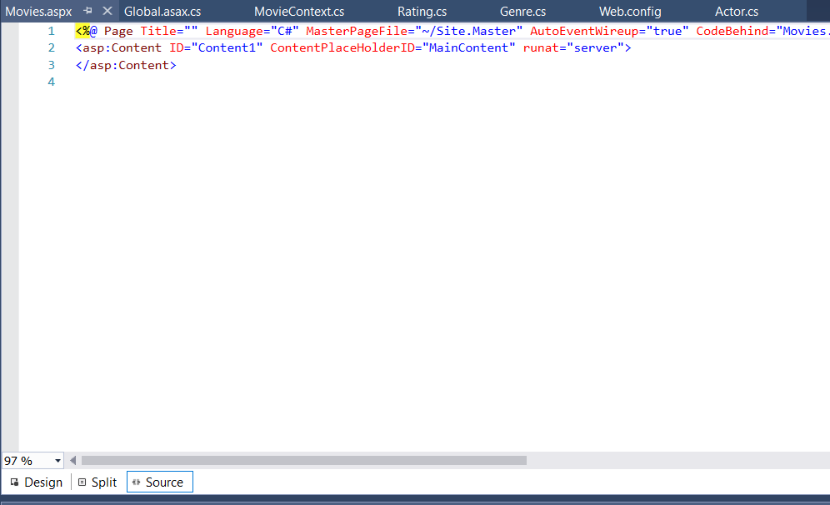
Switching to Design View
Choose Design at the bottom left.

Slide 19
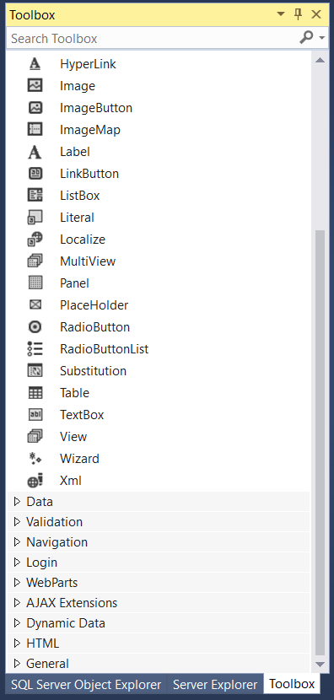
The Toolbox
Switch to the Toolbox tab on the left.

Slide 20
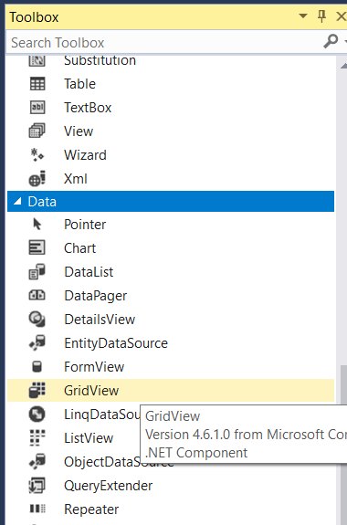
Adding controls to page
In the Toolbox, under the Data tab, double-click on GridView

Slide 21
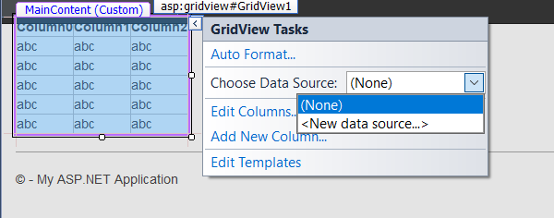
Adding controls to a page
Choose <New data source> from GridView Tasks

Slide 22
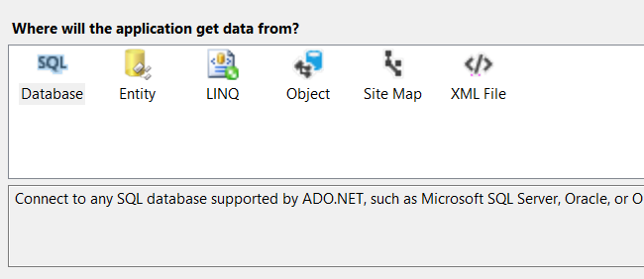
Adding Controls to a Page
Choose SQL Database and Choose OK.

Slide 23
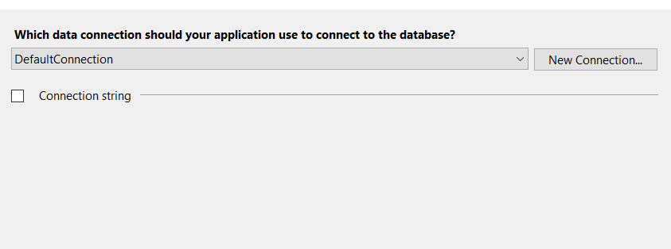
Adding Controls to Page
Choose DefaultConnection from the Dropdown and choose Next.

Slide 24
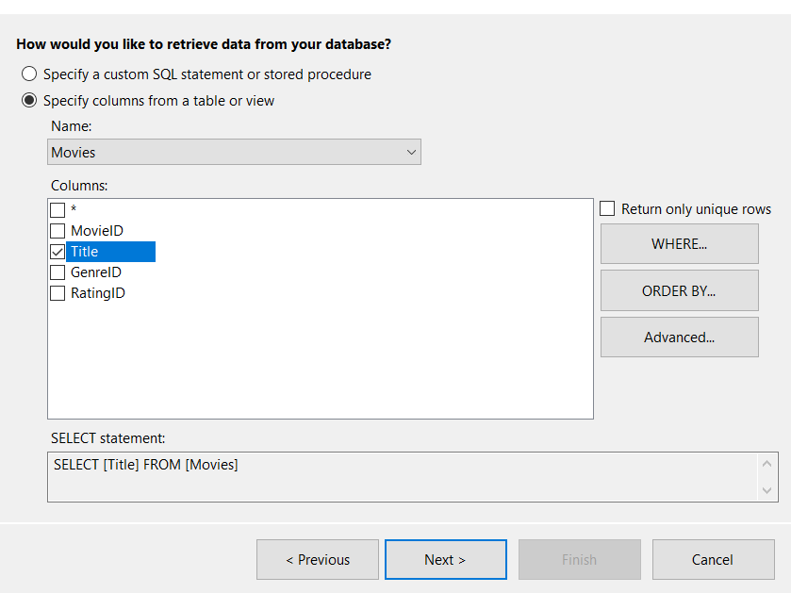
Adding controls to the page
Choose Movies from the dropdown and check the box next to Title.
Click Next
Then Finish

Slide 25
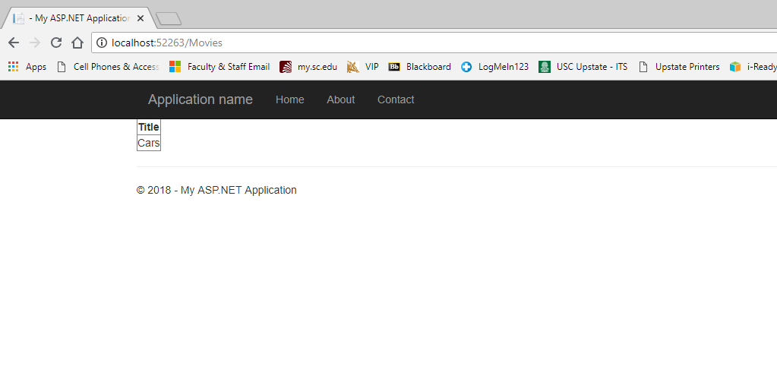
Adding Controls to the page
Run your project and Navigate to Movies.aspx

Slide 26
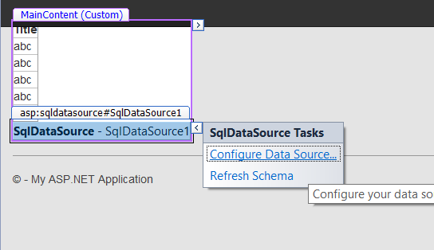
Changing the data that is displayed
Click on the arrow next to SqlDataSource and choose Configure Data Source.
Keep the DefaultConnection and choose Next

Slide 27
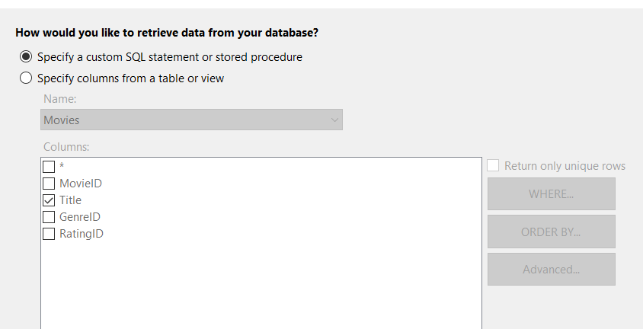
Configuring the data that is displayed
Choose Specify a custom SQL statement or stored procedure
Click Next

Slide 28
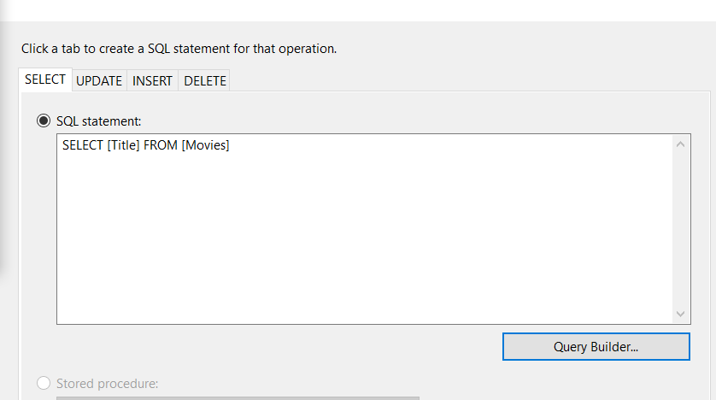
Configuring the data that is displayed
Click the Query Builder button

Slide 29
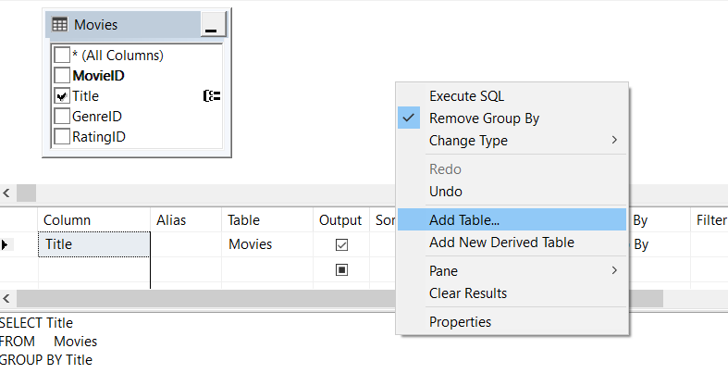
Configuring data to display
Click in an open spot in the top window and choose Add Table.

Slide 30
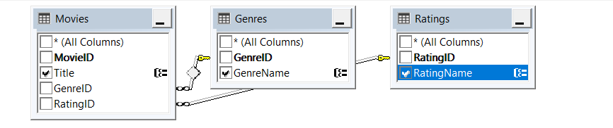
Configuring data to display
Add the Genres and Rating Tables
Check the GenreName box in the Genres table
Check the RatingName box in the Ratings table

Slide 31
Configuring data to display
Click through the rest of the wizard
If you get an alert asking if you’d like to refresh the columns choose “Yes”
Rerun the application to view the new data

